Slide 1
Overall system blow up CAD drawing
Annotate everything well in chamber
Use heating element model
Annotated diagrams/images for each claim point in application
By April 25th

Slide 2
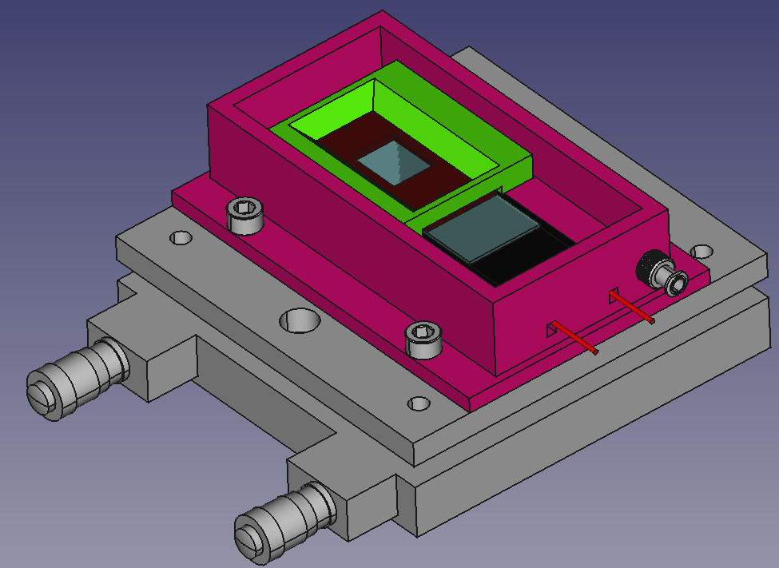

Slide 3
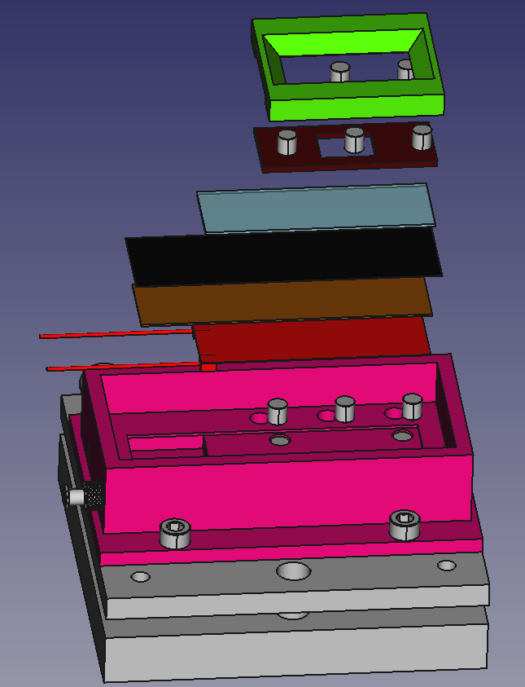
3D Printed Pressure Plate
Pressure Plate Embedded Magnets
Invisi-Slip Fluidic Device
Glass Slide
Maxi-Black Antireflective Material
Hard Setting Potting Compound
Positive Temperature Coefficient (PTC) Heating Element
Pressure Plate Chamber Mount Magnetics
Fluidic Device Stabilization Magnets
3D printed Chamber
M6 Mounting Machine Screws
Tilt Stage

Slide 4
Water Dipping Objective
Iron-Oxide Embedded Polydimethylsiloxane (PDMS)
3D Printed Pressure Plate
Fluorinated ethylene propylene (FEP) Film
Tubing
Water
Tissue
Maxi-Black Anti-Reflective Material
Neodymium Magnets
Hard Set Potting Epoxy
Slide Glass
Positive Temperature Coefficient (PTC) heater
3D printed Chamber

